Slide 1
Routing II

Slide 2
Routing Protocols to Determine Best Paths
Routing protocols—Used by routers to communicate with each other to determine the best path
Routers rate the reliability and priority of a routing protocol’s data based on these criteria:
Administrative distance (A D)—A number indicating the protocol’s reliability
Convergence time—Time it takes to recognise a best path in the event of a change or network outage
Overhead—The burden placed on the underlying network to support the protocol

Slide 3
Routing Protocols to Determine Best Paths
Routing Protocol | Type | Algorithm Used
R I P (Routing Information Protocol) | I G P | Distance-vector
R I Pv2 (Routing Information Protocol, version 2) | I G P | Distance-vector
O S P F (Open Shortest Path First) | I G P | Link-state
I S-I S (Intermediate System to Intermediate System) | I G P | Link-state
E I G R P (Enhanced Interior Gateway Routing Protocol) | I G P | Advanced distance-vector
B G P (Border Gateway Protocol) | E G P | Advanced distance-vector or path vector

Slide 4
Interior and Exterior Gateway Protocols
I G P (interior gateway protocols)—Used by core routers and edge routers within autonomous systems and are often grouped according to the algorithms they use to calculate best paths:
Distance-vector routing protocols—Calculate path on the basis of the distance to that destination
Link-state routing protocols—Enables routers to communicate beyond neighbouring routers in order to independently map the network and determine the best path

Slide 5
Interior and Exterior Gateway Protocols
E G P (exterior gateway protocols)—Used by edge routers and exterior routers to distribute data outside of autonomous systems
The only E G P currently in use is B G P

Slide 6
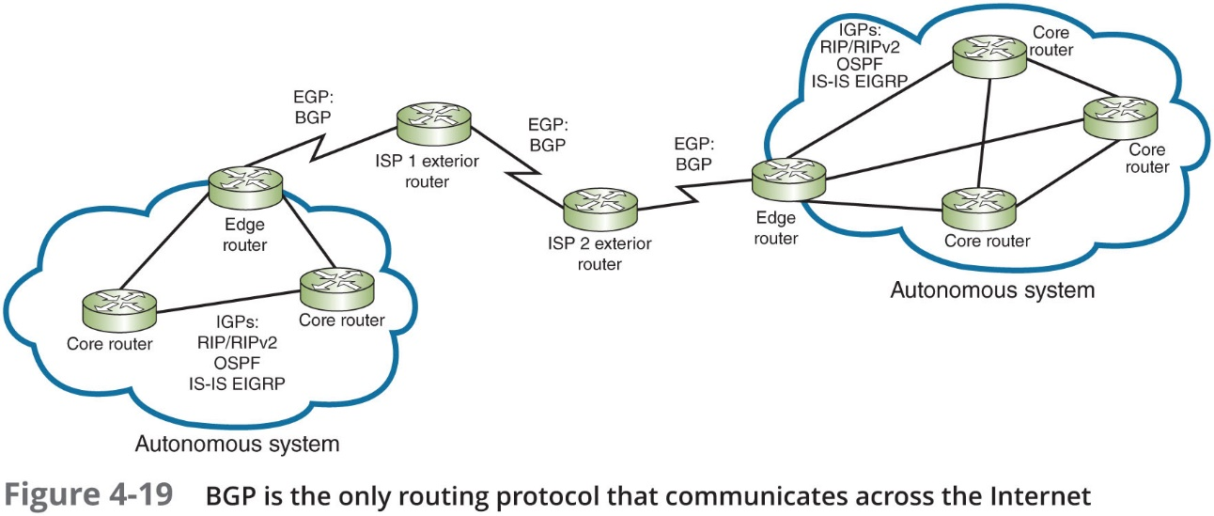
Interior and Exterior Gateway Protocols

Slide 7
Interior and Exterior Gateway Protocols
O S P F (Open Shortest Path First)—An I G P and a link-state protocol used on interior or border routers
Introduced as an improvement to R I P
Characteristics:
Supports large networks—Imposes no hop limits (unlike R I P)
Uses a more complex algorithm for determining best paths
Shared data—Maintains a database of other routers’ links
Low overhead, fast convergence—Demands more memory and C P U power for calculations, but keeps network bandwidth to a minimum and provides a very fast convergence time
Stability—Uses algorithms that prevent routing loops
Multi-vendor routers—Supported by all modern routers

Slide 8
Interior and Exterior Gateway Protocols
I S-I S (Intermediate System to Intermediate System)—An I G P and link-state routing protocol:
Uses a best-path algorithm similar to O S P F
Is designed for use on core routers only (unlike O S P F)
Not handcuffed to I P v 4 (like O S P F) so it’s easy to adapt to I P v 6
Service providers generally prefer I S-I S because it’s more scalable than O S P F

Slide 9
Interior and Exterior Gateway Protocols
E I G R P (Enhanced Interior Gateway Routing Protocol)—An advanced distance-vector protocol that combines some of the features of a link-state protocol
Often referred to as a hybrid protocol
Fast convergence time and low network overhead
Easier to configure and less C P U-intensive than O S P F
Supports multiple protocols and limits unnecessary network traffic between routers
Originally proprietary to Cisco routers

Slide 10
Interior and Exterior Gateway Protocols
B G P (Border Gateway Protocol)—The only current E G P and is known as the “protocol of the Internet”
Can span multiple autonomous systems
A path-vector routing protocol that communicates via B G P-specific messages that travel between routers
Determines the best paths based on many different factors
Can be configured to follow policies that might avoid a certain router or instruct a group of routers to prefer a particular route
The most complex of the routing protocols

Slide 11
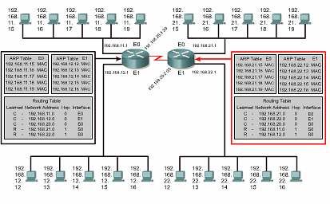
ARP Tables and Routing Tables

Slide 12
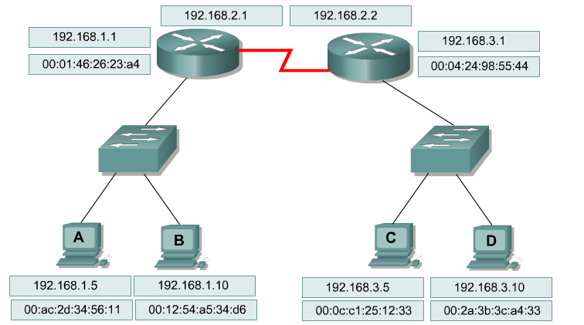
Routing – Role of Layer 2 and Layer 3 Addressing
Remember: Regardless of the routing protocol, packets travel across each individual link in a new frame of the appropriate format for the protocol running over that link.
1. From Host A to the router FastEthernet interface: Ethernet frame
2. Over the serial link on the left router to the right router: HDLC frame
3. From the router FastEthernet interface to Host D: Ethernet frame

Slide 13
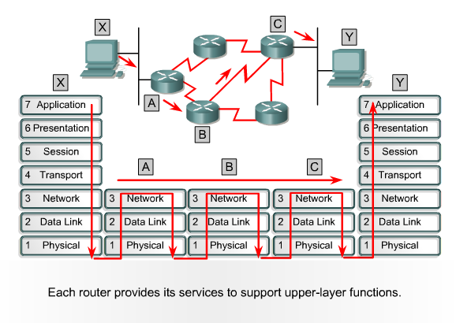
Forwarding an IP Packet
When a frame is received at a router interface.
The MAC address is checked to see if the frame is either addressed to the router interface or is a broadcast
The frame header and trailer are removed, and the packet is passed up to Layer 3
The routing table is examined to check for a match with the destination IP address of the packet
A match will identify the IP address of the directly connected next hop interface.
The next hop IP is only used to look up the MAC address of the next hop interface in the ARP table to construct a frame
The packet is placed into the new frame with the MAC address of the next hop interface as the destination address
The frame is queued on the appropriate outgoing interface until it is transmitted

